Slide 1

Computer Vision
Introduction

Slide 2
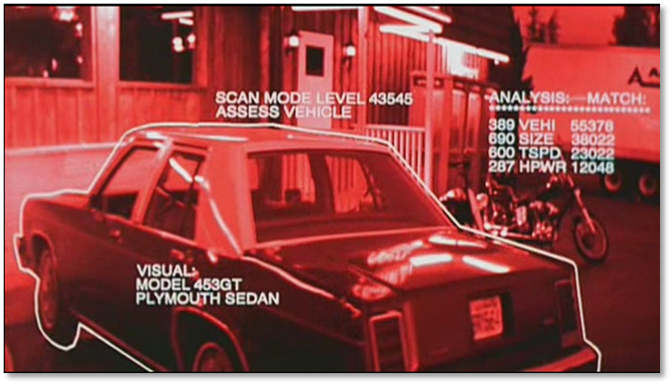
Goal Of Computer Vision

Slide 3
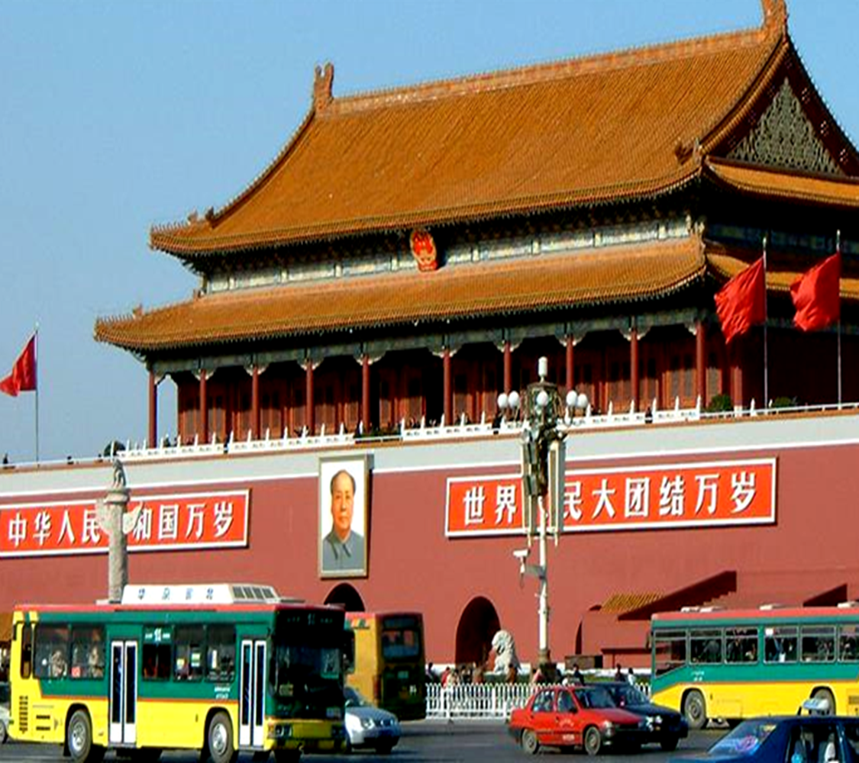
Recognizing Objects and people Enable a machine to "understand" images and videos.
BUILDING
FLAG
STREET LAMP
BANNER
FACE
BUS
WALL
CAR

Slide 4
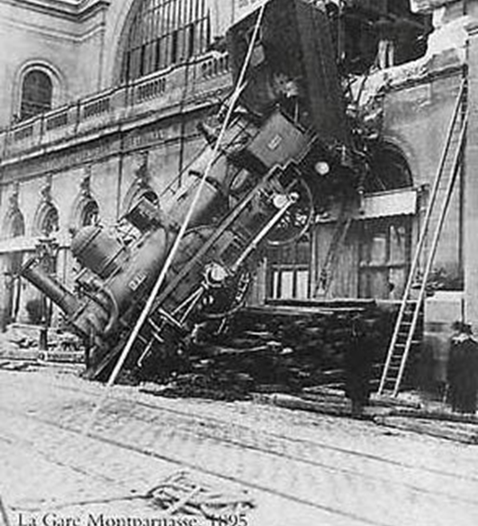
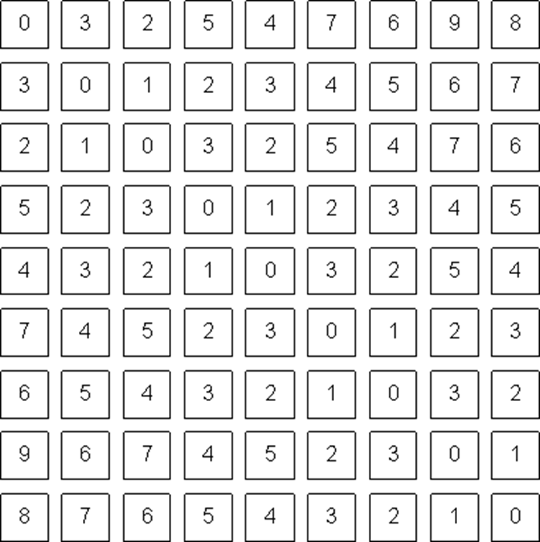
To Bridge the gap between pixels and "meaning"
What We See
What a computer see

Slide 5
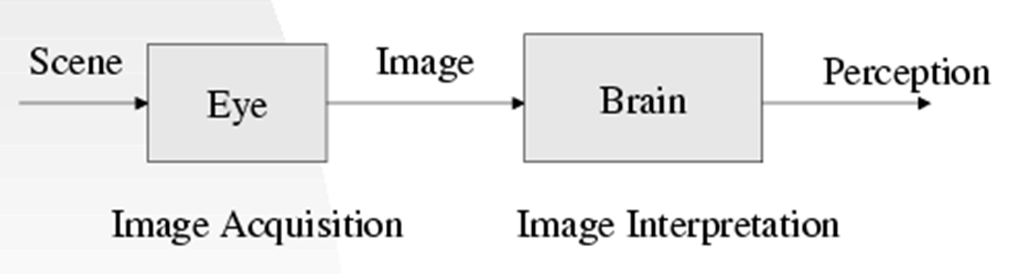
Vision
Vision is the process of discovering what is present in the world and where it is by looking.

Slide 6
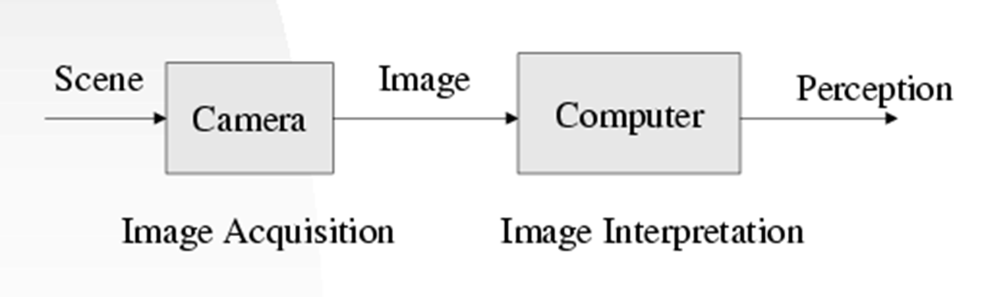
Computer Vision
Computer Vision is the study of analysis of pictures and videos to achieve results like those as by people.
Automatic Understanding:
a. Computer properties of the 3D world from visual data (measurement)
b. Algorithms and representations to allow a machine to recognize objects, people, scene and activities. (perception and interpretation)

Slide 7
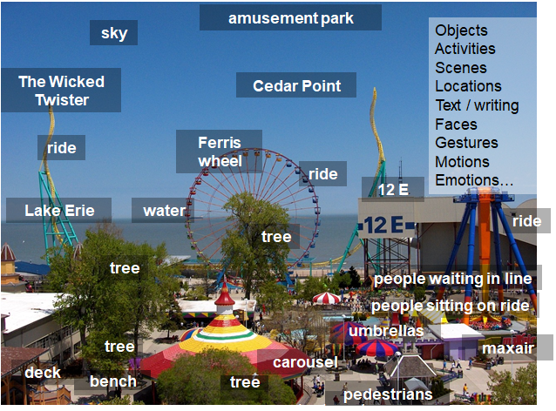
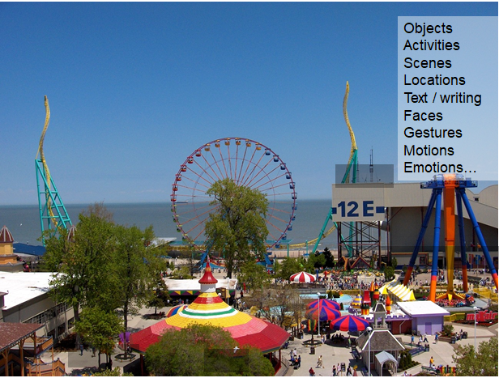
Vision as a source of semantic information

Slide 8
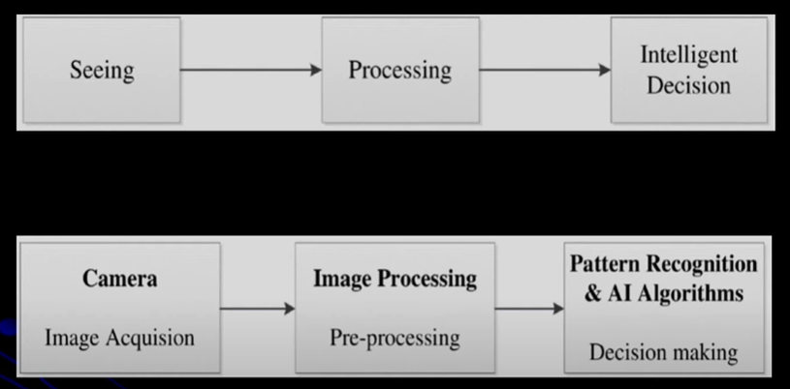
Similarity between human visual system and computer vision system: Both use cameras or eyes to see objects, images, or videos.
Both convert light into electrical signals.
Both involve processing of information.

Slide 9
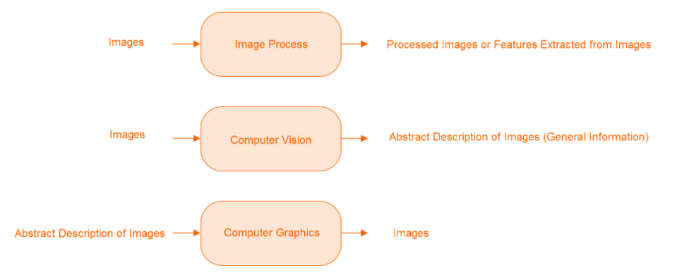
Difference Between Computer Vision, Computer Graphics and Image Processing

Slide 10
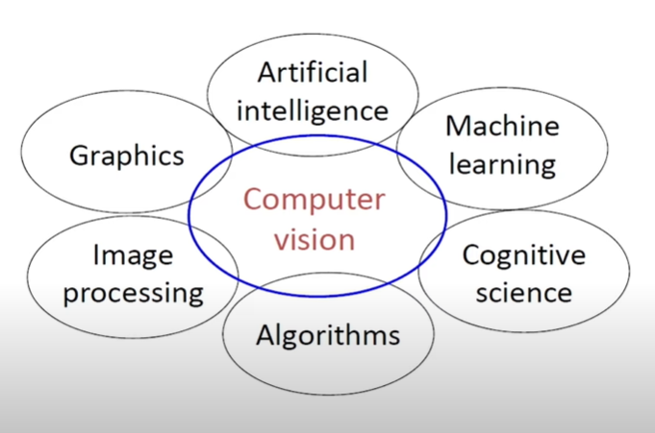
Various Disciplines of Computer Vision

Slide 11
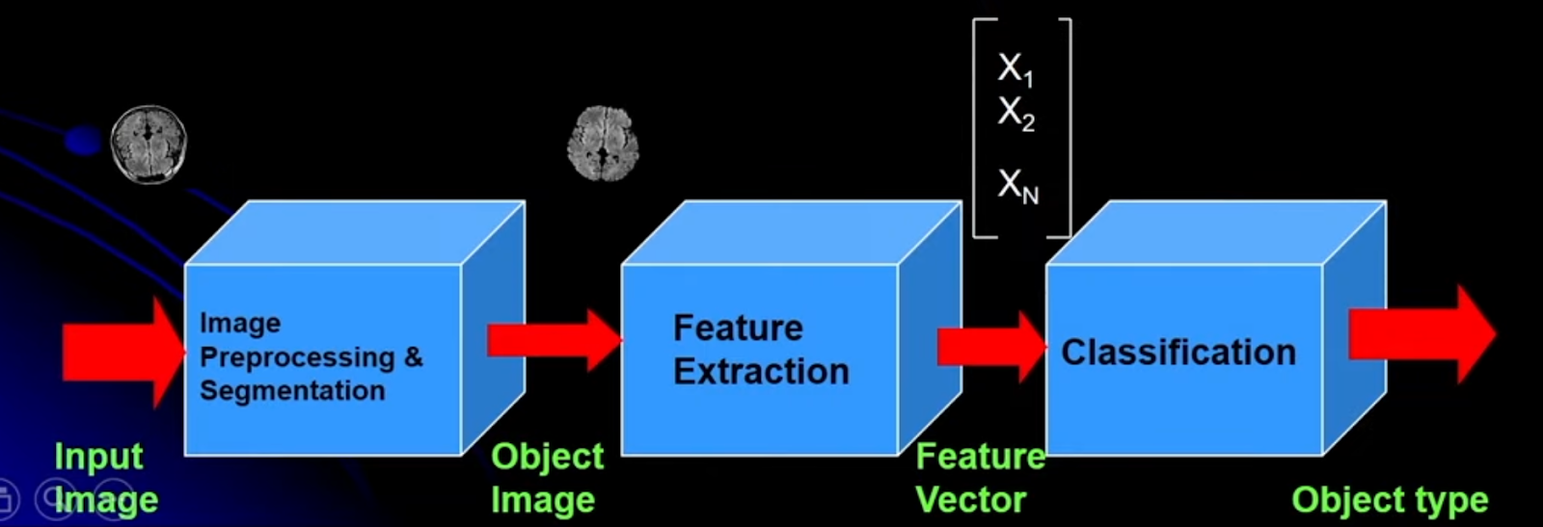
Fundamentals of Computer Vision
Input Image
Processing (Image enhancement and Image reconstruction):
Initially need to do- Image Pre- processing: To improve the quality of image. For example, as if to remove noise in the image.
Image Segmentation (Isolating Objects): It means partitioning of an image into connected homogeneous regions.
Feature Extraction (Representation and Description): From image, features are extracted. For example, in the above image there is the feature vector.
Classification (Object recognition): Based on extracted features, classification is conducted.
These above steps or block diagram is of Computer Vision, can also be called as Image Analysis System. In short, the first step is to do the image pre-processing, then to extract some features, and based on these features, need to do the classification.

Slide 12
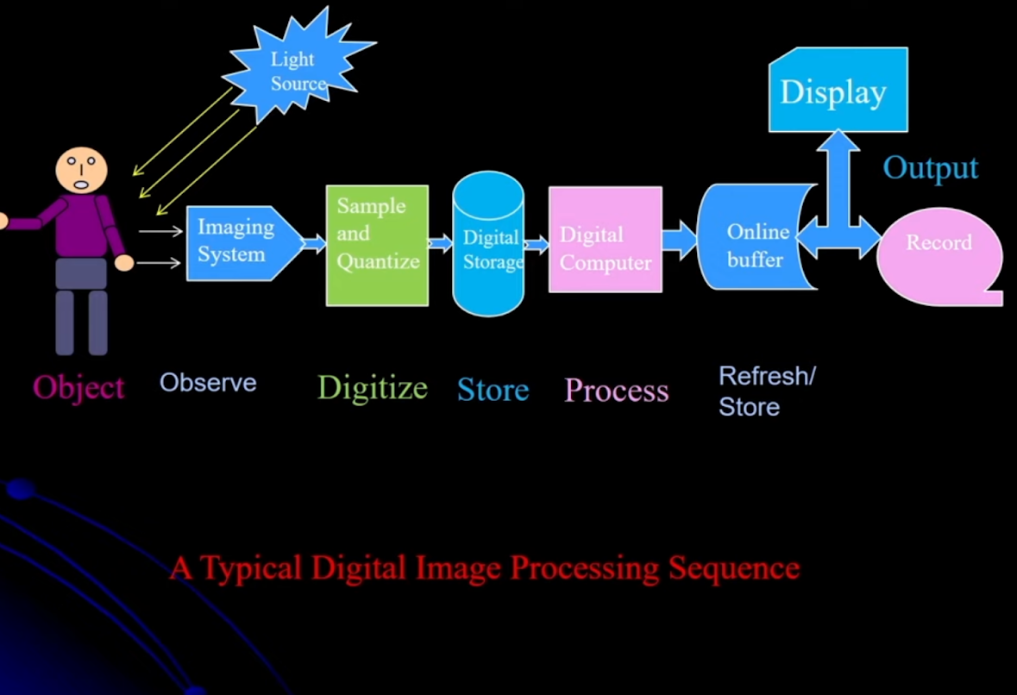
Image Formation
The light photos are the analog signal. Analog means it is a continuous function of time.
The analog signals are converted into digital images by process of sampling and quantization.
First the sampling along the x direction and sampling along y direction is done as spatial sampling. After sampling the quantization of the intensity values is done. So sampling and quantization is done to convert an analog image to digital image.

Slide 13
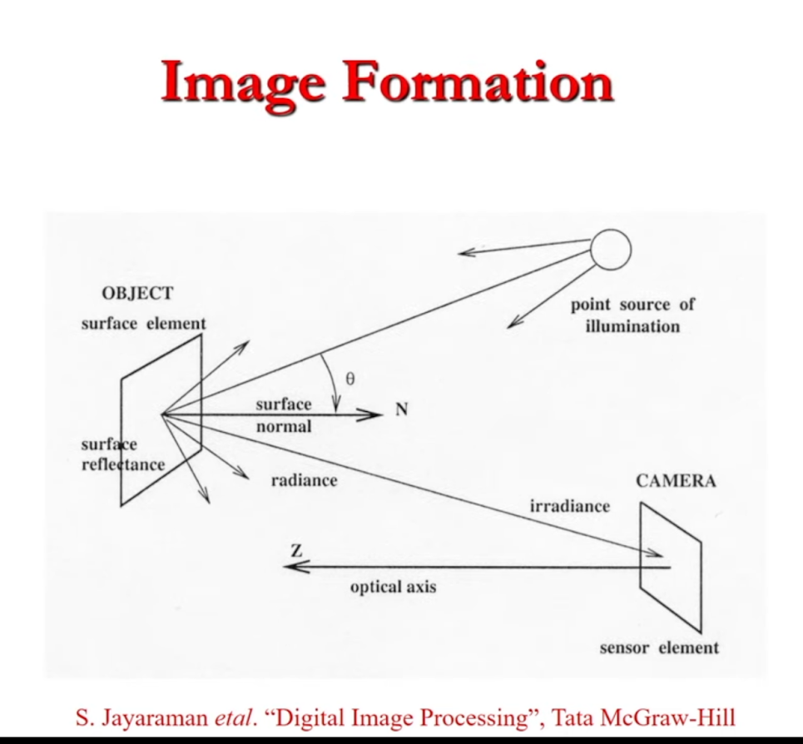
Image Formation (Cont..)
The light is coming and reflected by the surface. And after this, the radiance is coming and further captured by the camera. So, the camera is getting the analog signal which is then converted into a digital image. This is the simple image formation principle.

Slide 14
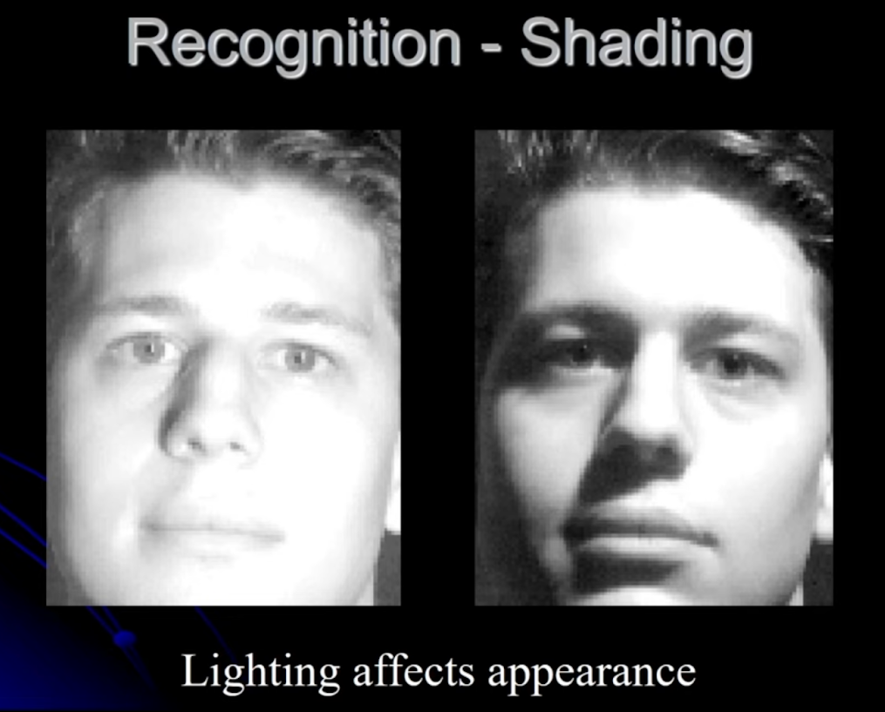
Physics of Imaging
Here in this computer vision system, the computer needs to identify these two faces; but different lighting/ shading conditions. To identify these faces Computer vision depends upon geometry (geometry of camera), physics (measurement of light as well as geometrical configuration of camera), and the nature of objects in the world.

Slide 15
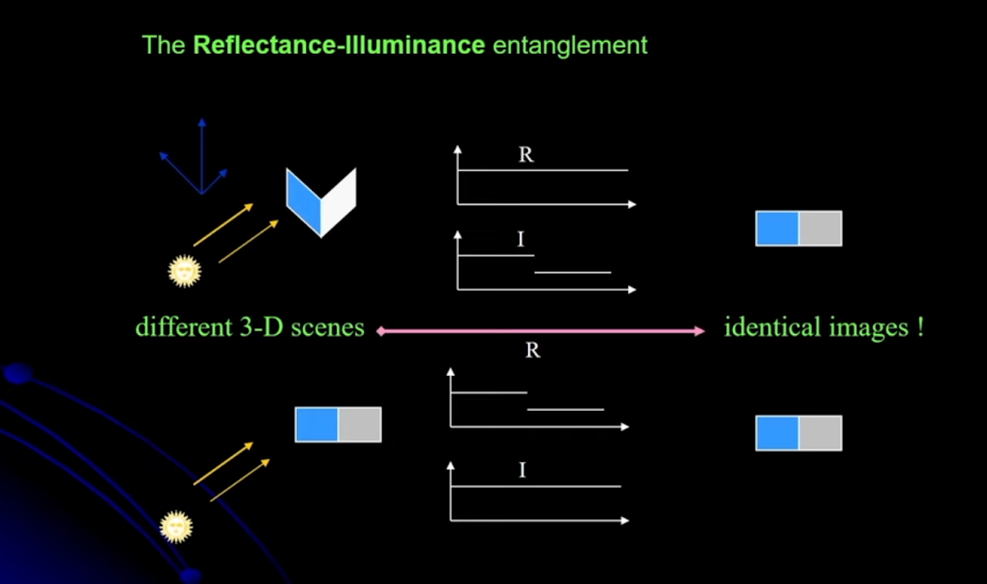
Inverse Problem in Computer Vision
First Inverse Problem:-
Biological & digital Image processing: It converts 3D to 2D projections.-
This image is called 3D to 2D projection. For example, the 3D contains x, y z coordinates details and after taking an image only x and y coordinates are left, the z coordinate value gets lost, which is the depth information.
Here Vision is an ill posed inverse Problem as it loses the third dimension (e.g.. Range or depth).
Second Inverse Problem:-
Reflectance Illumination problem: In the above figure in the first case, there are two different surfaces that are illuminated by the light source. This is illuminated by the light source. In the first case, the reflectance gives the output of only one side of the plane while the other side gets illuminated. After illumination the image will be of one side only.
In the second case, if the image (2D) is illuminated by this light source. Output will still be the same as the first one. So then the vision is having an ill-posed inverse problem.

Slide 16
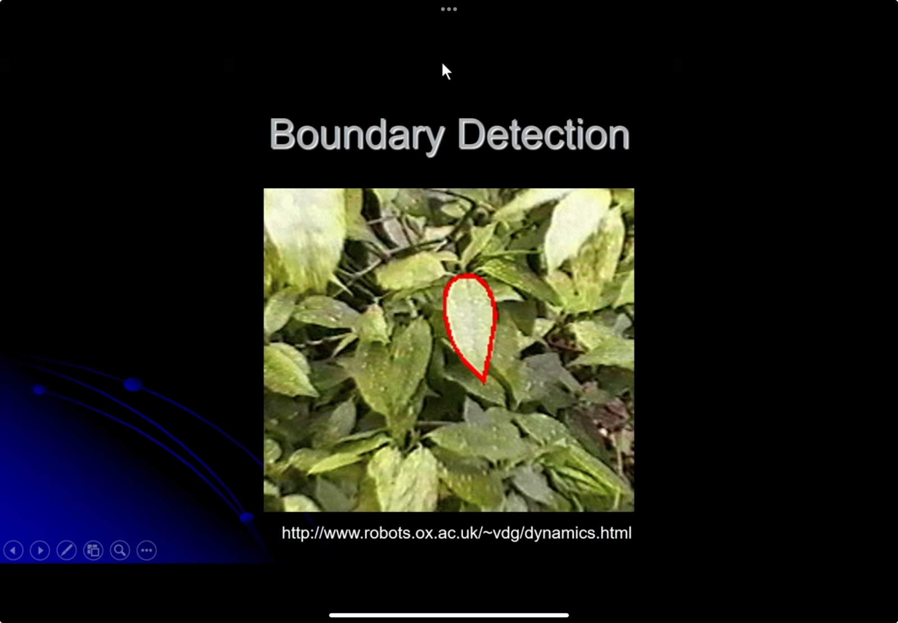
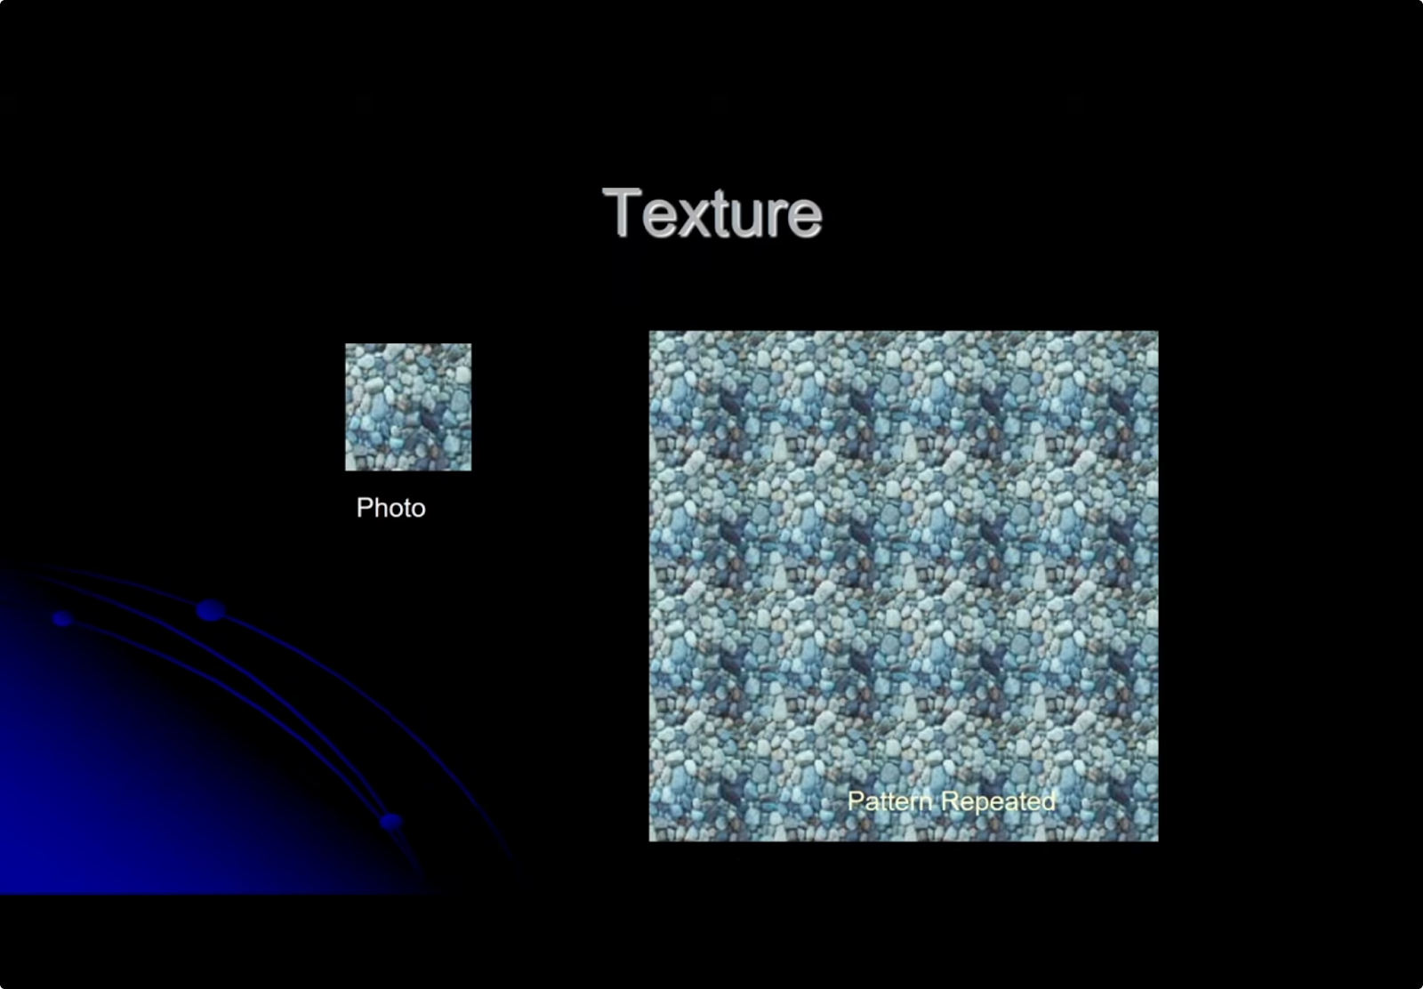
Improve Computer vision
Modeling + Algorithms
Steps are:
Build a simple model of the world. (e.g. Flat, uniform intensity)
Find appropriate algorithms.
Experiment on the real world.
Update model.
Early Vision in one image:
-Edge detection
-Boundary detection

Slide 17

Early vision in Multiple Images
Like stereo vision with multiple views. Considering two or more cameras.
Considering multiple cameras.
Stereopsis: What we know about the world having 2 eyes. (Depth information)
Structure from Motion: What we know about the world having many eyes or our eyes moving.
Humans use motion parallax: In the moving object the camera will get many images, the main work is to determine the corresponding point between these images from these points the structure information is collected. This is one getting structure information from motion.

Slide 18
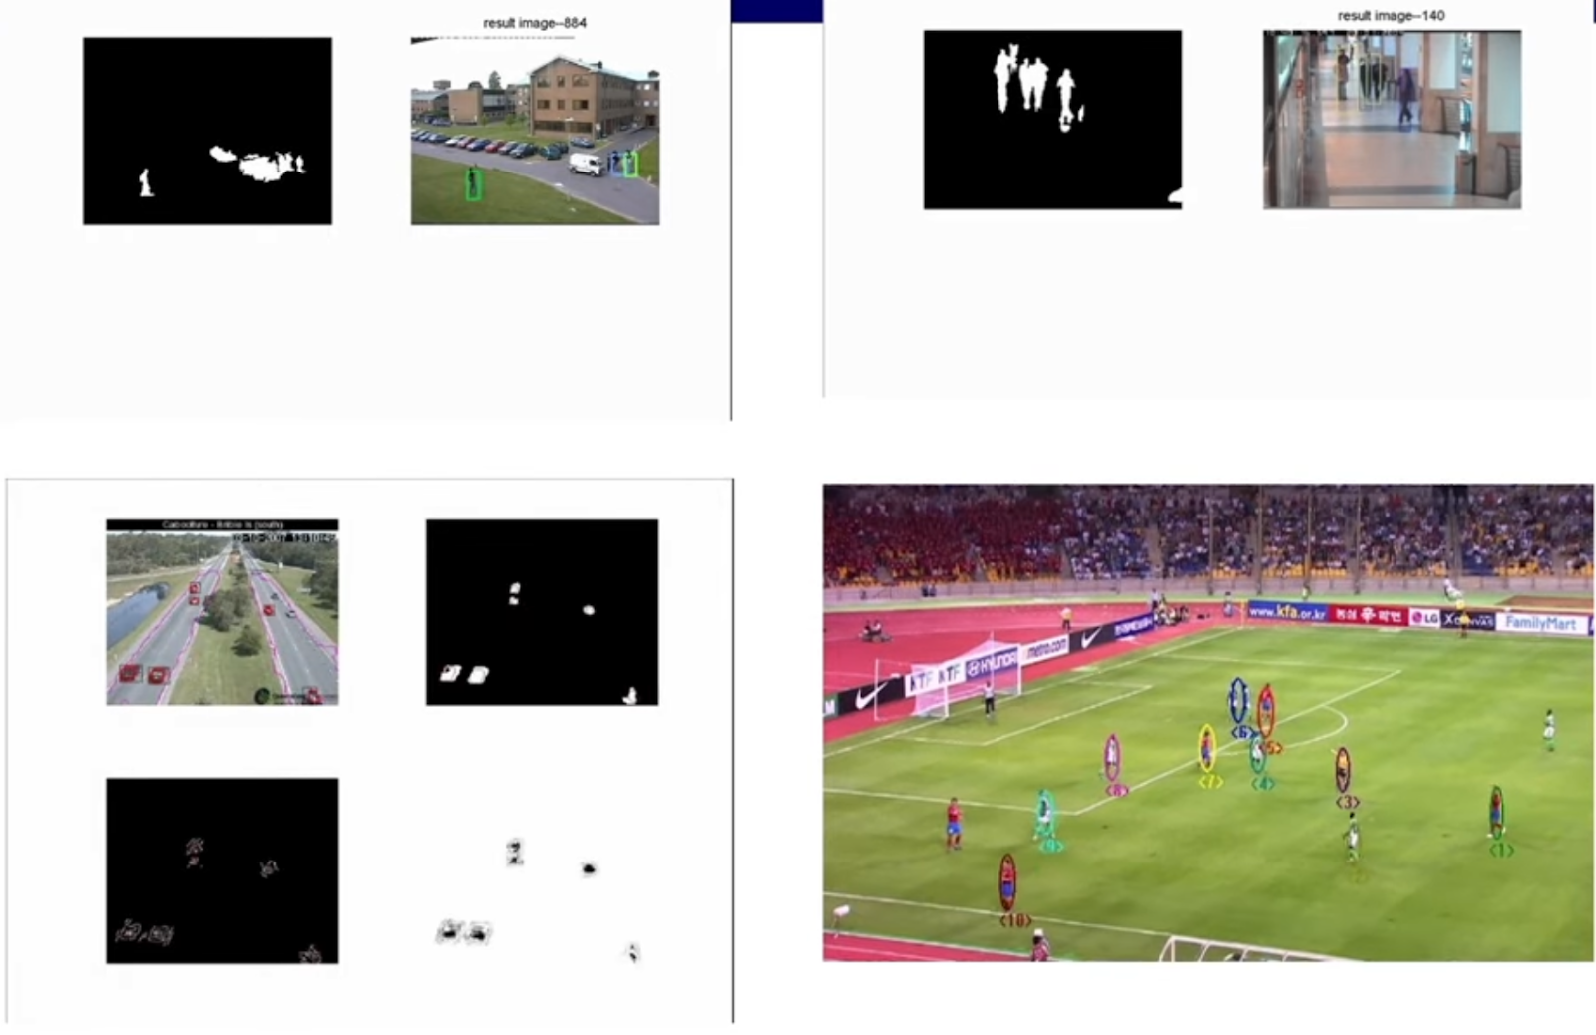
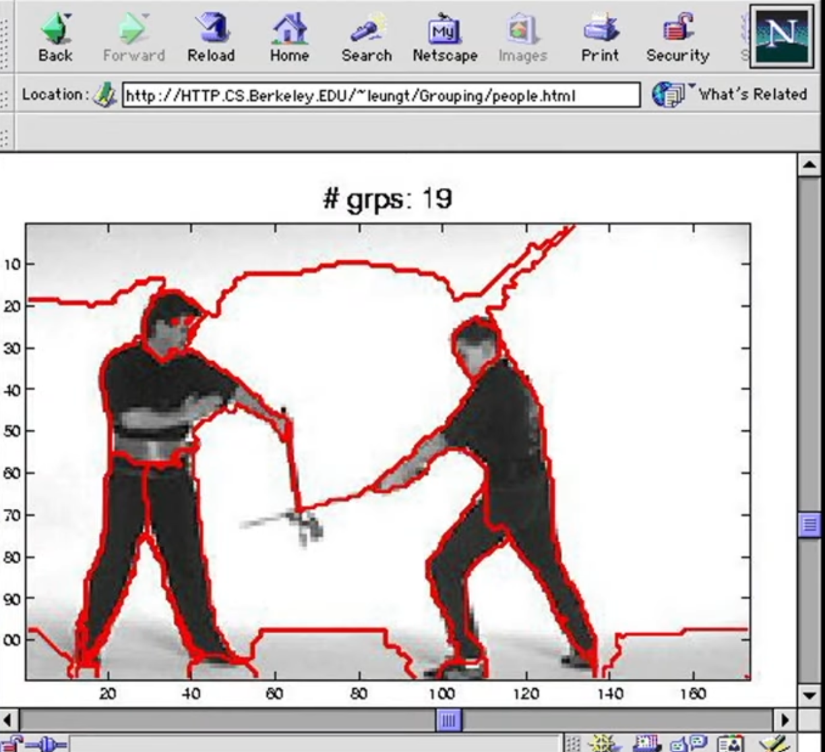
Mid – Level Vision
In Mid-level vision to find coherent structure so as to break the image or movie into smaller units, these problems are considered as:
Segmentation of image/ video: It means partitioning of the image/ video into connected homogeneous regions.
Tracking in the video: Keeping track of a moving object through a long sequence of views.

Slide 19
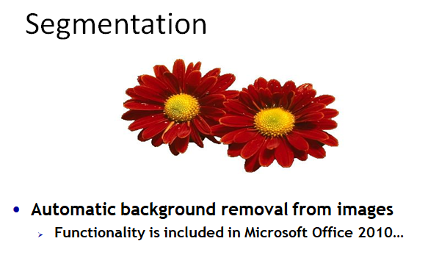
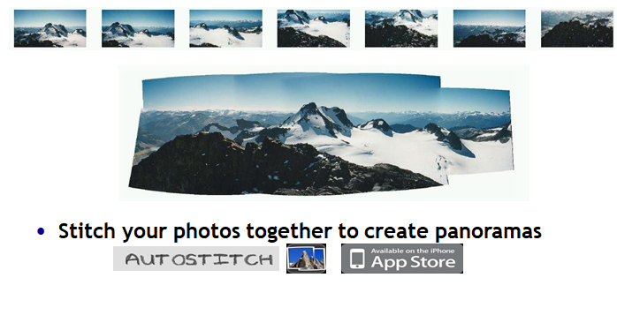

Slide 20
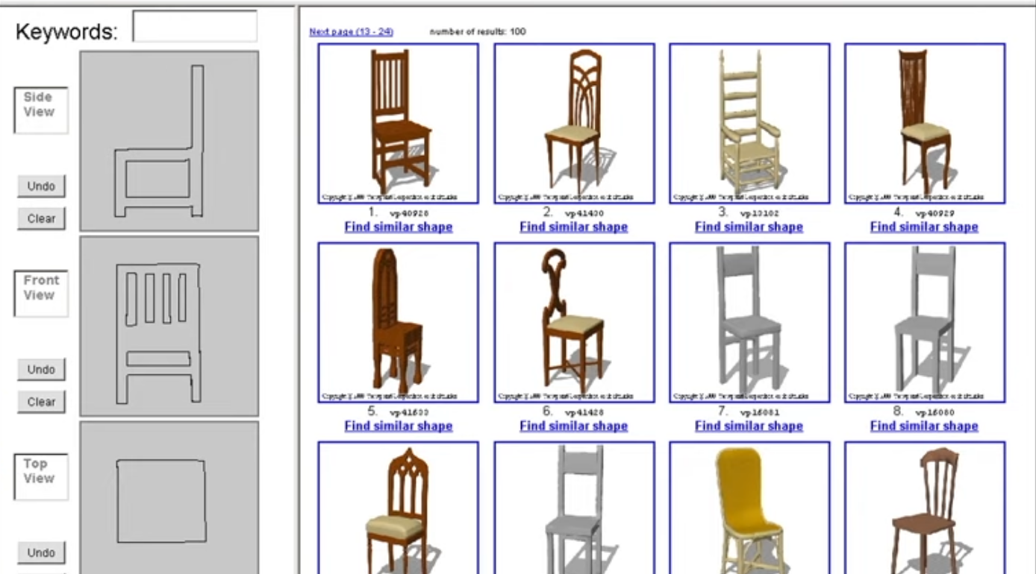
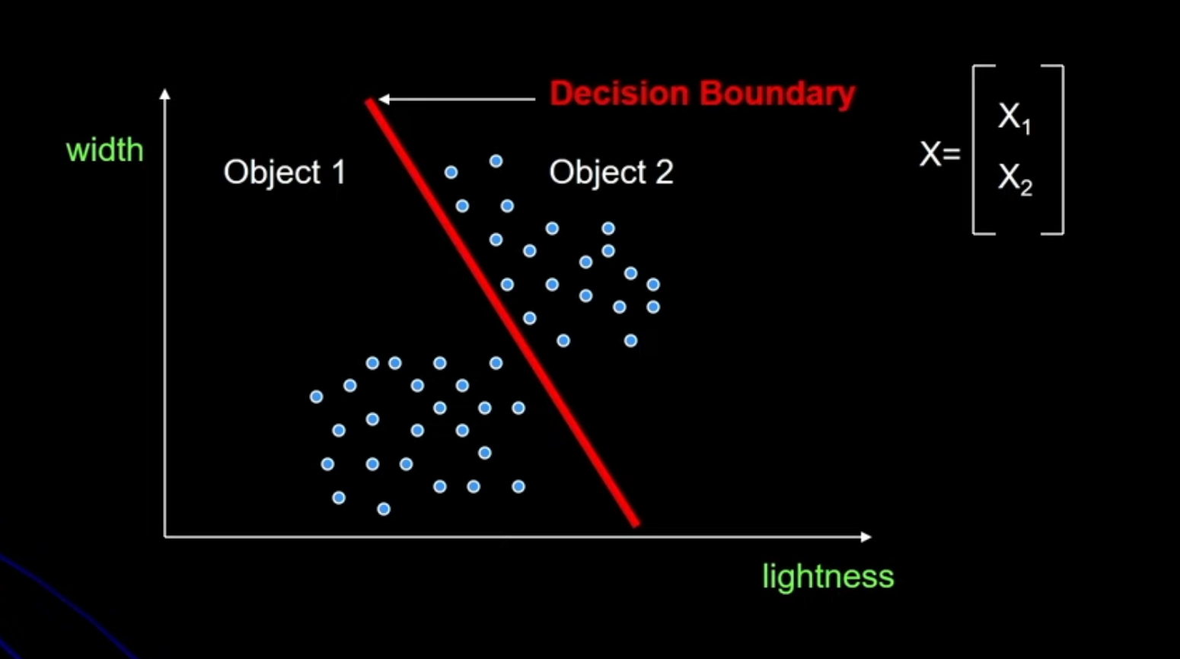
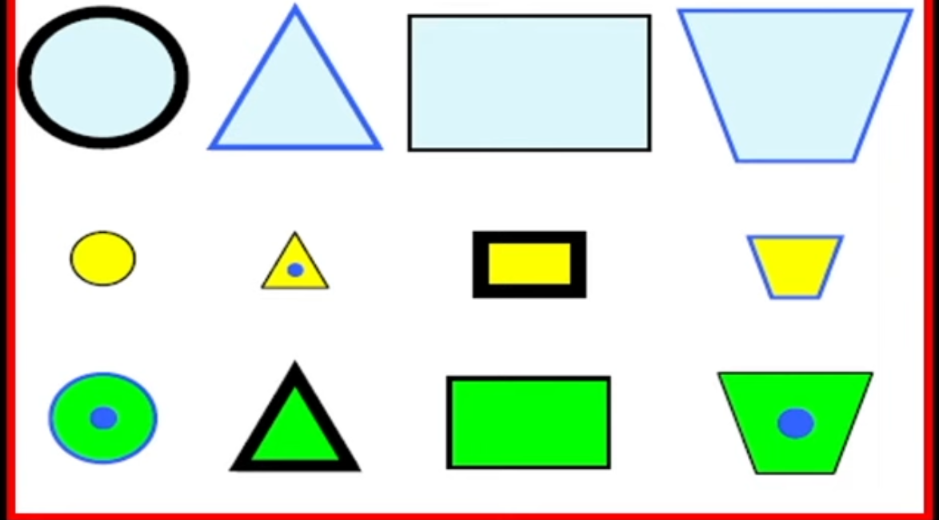
High-Level Vision
(Geometry):
The relationship between object geometry and the image geometry to:
How the outline of a curved object is formed, and what it looks like.
How the outline of a curved object moves around as you view it from different directions.
(Probabilistic):
Using classifiers and probability to recognize objects:
How to find objects that look the same from view to view with a classifier.
Break up objects into big, simple parts, find the parts with a classifier, and then reason about the relationships between the parts to find the object.
(Clustering):
This is the basic concept of finding the similarity between the patterns between the objects

Slide 21
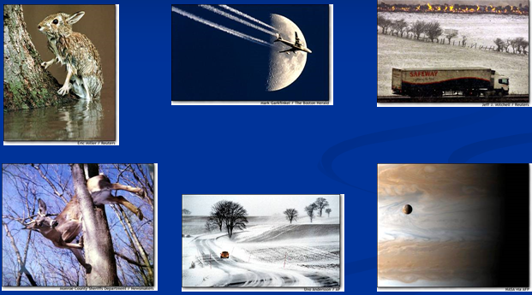
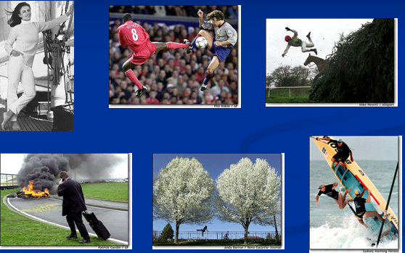
Why Computer Vision
Example:- Find People in images.
Question: Does Image 1 or Image 2: contain an image of a person?
An image is worth 1000 words
Many biological systems rely on vision.
The world is 3D and dynamic
Cameras and computers are cheap.
And so on....
IMAGE 1
IMAGE 2

Slide 22
Why Computer Vision? (Cont.)
Visual Understanding:
Enables machines to interpret and comprehend visual data, akin to human visual perception.
Automation and Efficiency:
Automates tasks traditionally reliant on human vision, enhancing operational efficiency across industries.
Object Recognition:
Identifies and categorizes objects within images and videos.
Decision-Making Enhancement:
Enhances decision-making by providing insights derived from visual information.
Human-Machine Interaction:
Improves interfaces through the recognition of gestures, facial expressions, and movements.

Slide 23
Applications of Computer Vision
Medical Imaging:
Assists in diagnostics and treatment planning through advanced analysis of medical images.
Autonomous Systems:
Crucial for navigation and decision-making in autonomous vehicles, planes, missiles, and robotic systems.
Space Exploration:
Used in space missions for terrain mapping, object recognition, and autonomous navigation.
Manufacturing, Quality Control:
Used for quality control in manufacturing, ensuring products meet standards.
Medical Imaging and Analysis:
Contributes to medical imaging and analysis, aiding in diagnostics and research.
Entertainment and Gaming:
Enhances gaming experiences through features like gesture control and facial recognition.
Human Pose Estimation:
Used to estimate and understand human body poses in various applications.
Natural Language Processing (NLP):
Supports NLP tasks by analyzing visual context in conjunction with textual information.
Aid to the Blind, ASL Recognition:
Employs computer vision to assist individuals with visual impairments and recognize American Sign Language (ASL).
Surveillance, Security, Biometrics:
Enhances security through real-time monitoring, facial recognition, and biometric identification.
Image Retrieval:
Utilized for retrieving images from large databases based on visual content.
Search and Rescue Robots:
Enables robots to navigate and locate objects or individuals in complex environments.

Slide 24
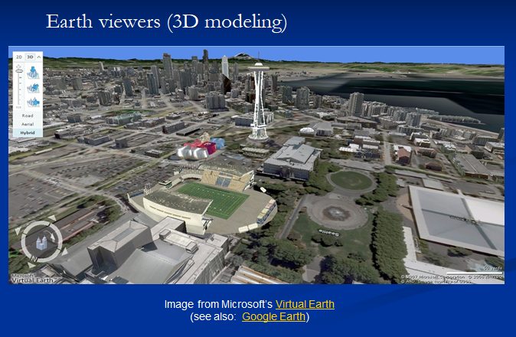
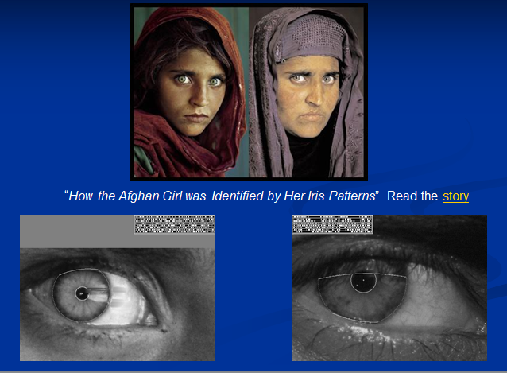
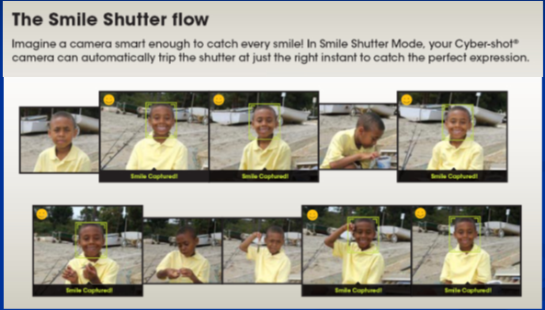
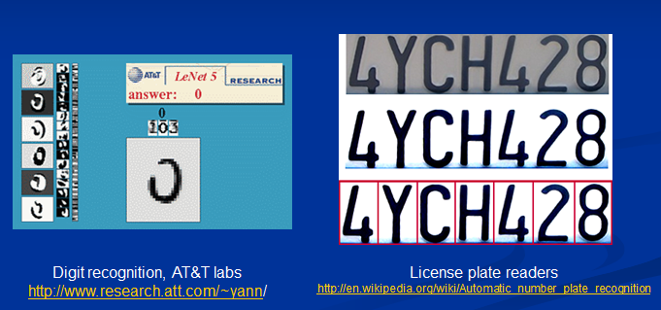
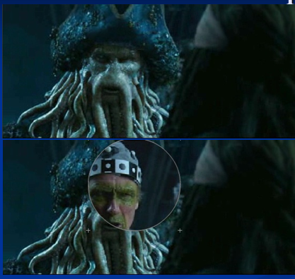
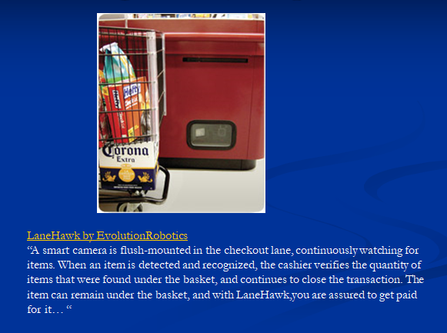
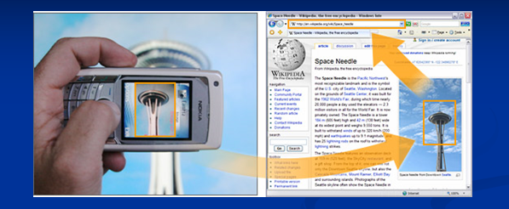

Slide 25
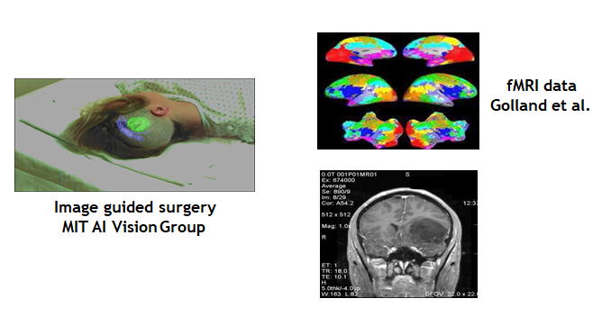
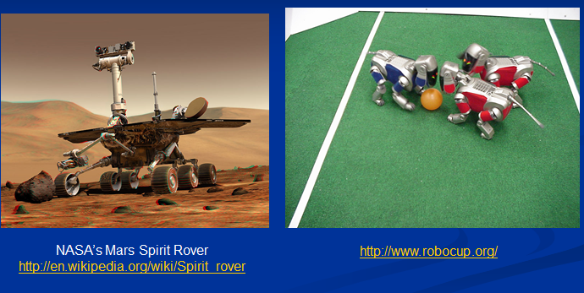
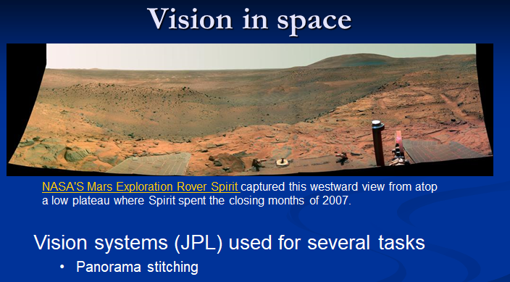
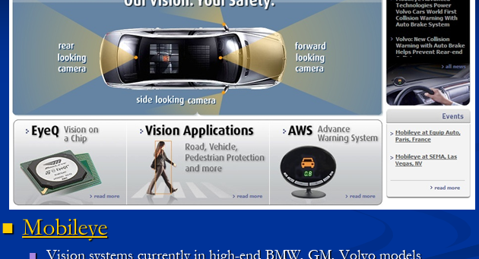
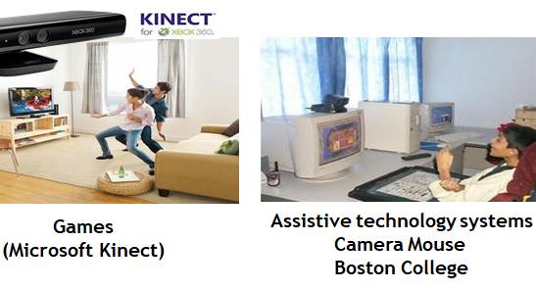
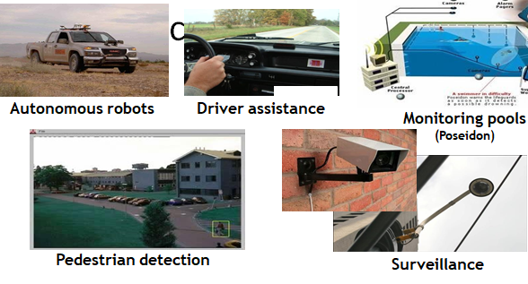

Slide 26
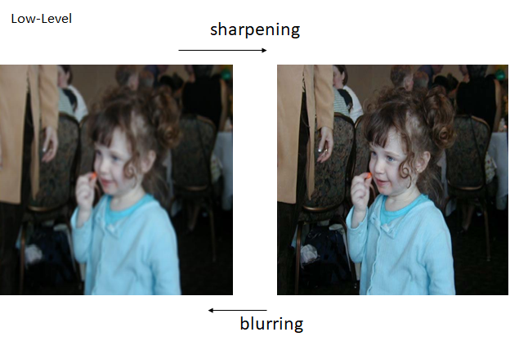
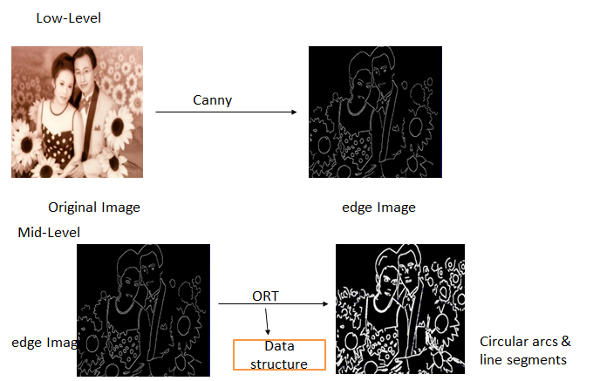
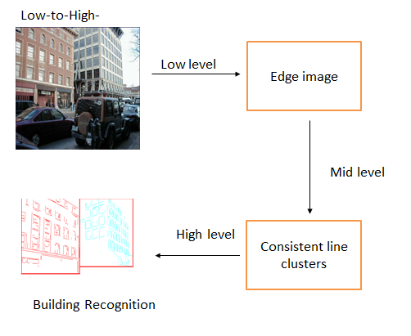
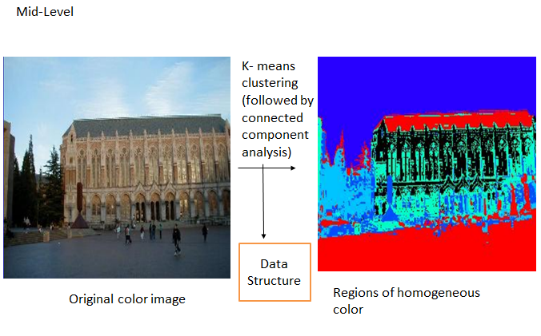
Stages of Computer Vision
Low – Level (image-> image)
Mid- Level (images -> features)
High – Level (features -> analysis)
Directions to Computer vision
Science:- Foundation of perception. How do we see?
Engineering:- How do we build systems that perceive the world?

Slide 27
Challenges in Computer Vision
Data Variability: Computer vision systems face challenges due to the variability in visual data. Factors such as different lighting conditions, diverse viewpoints, and complex backgrounds can affect the performance of algorithms.
Object Recognition Hurdles: Identifying and recognizing objects in images becomes challenging when dealing with complex shapes, varying orientations, and occlusions.
Ethical Considerations: The deployment of computer vision technologies raises ethical concerns, including biases in algorithms and the potential impact on privacy and fairness.

Slide 28

Evolution of Computer Vision
1970s-80s
Vision and AI
Vision as part of AI for mimicking human intelligence.
Initial belief in solving visual input for advanced reasoning.
1980s-90s
Mathematical Advances
Introduction of image pyramids and stereo-based shape recognition.
Emergence of physics-based vision and statistical learning.
2000s
Computational Photography and Features
Integration of vision and graphics.
Rise of feature-based techniques and computational photography.
Efficient global optimization algorithms.
2010s-Present
Trends
Continued interplay between vision, graphics, and machine learning.
Dominance of machine learning in visual recognition.
Integration of advanced techniques like deep learning.

Slide 29
ANY QUERY?

